Slide 1
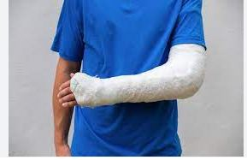
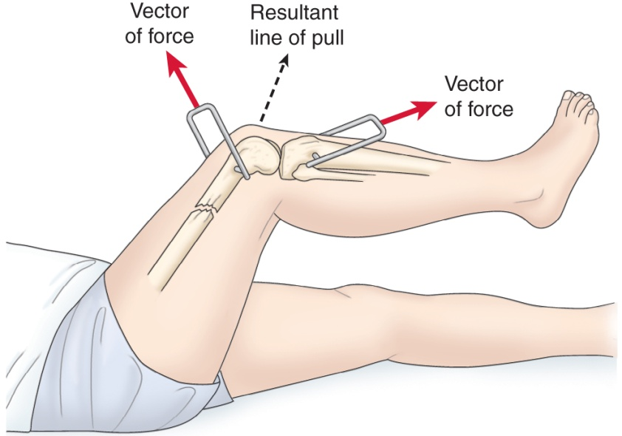
University of Basrah
College of Nursing
Fundamentals of Nursing Department
Second stage
Adult Nursing (II) 2nd Stage
Lecture 1 (practice )
Musculoskeletal Care Modalities
Dr. Mohamad Abdulridha
Orthopedic Surgeon
M.B.CH.B F.I.C.M.S (ORTHO)

Slide 2
Cast
A rigid, external immobilizing device
Uses
Immobilize a reduced fracture
Correct a deformity
Apply uniform pressure to soft tissues
Support to stabilize a joint
Materials—non plaster (fiberglass), plaster

Slide 3
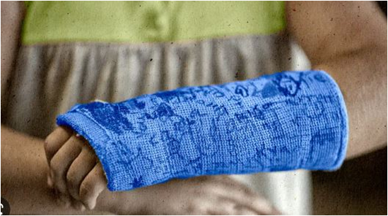
Fiberglass Casts
composed of polyurethane resins that have the versatility of plaster but are lighter in weight, stronger, water resistant, and more durable than plaster.
In addition, fiberglass casts facilitate radiographic imaging better than and have the benefit of reaching full rigidity within 30 minutes of application

Slide 4
Plaster Casts
Casts made of plaster of Paris are less costly and achieve a better mold than fiberglass casts; however, they are heavy, not water resistant, and can take up to 24 to 72 hours to dry post application.

Slide 5
Types of Casts:
Short arm cast 2.Long arm cast
Short leg cast 3.Long leg cast
Walking cast ( long or short) reinforced for strength
Body cast: encircle the trunk
Shoulder spica cast: a body jacket that enclosed the trunk and the shoulder and elbow
Hip spica cast: enclose the trunk and lower extremity ( double hip spica cast ( includes both legs

Slide 6
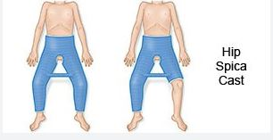
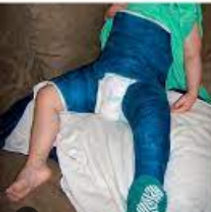
Shoulder spica cast

Slide 7
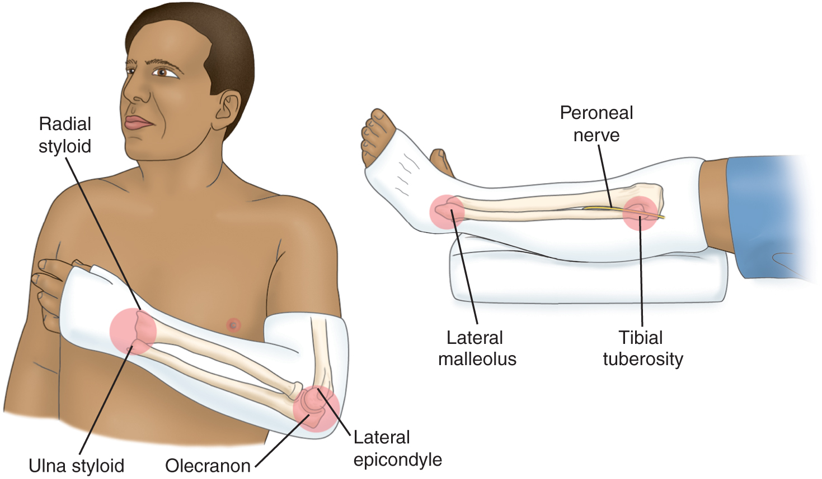
Long-Arm and Short-Leg Cast and Common Pressure Areas

Slide 8
Teaching Needs of the Patient with a Cast
Prior to cast application
Explanation of condition necessitating the cast
Purpose and goals of the cast
Expectations during the casting process- for example heat from hardening plaster
Cast care: Hygiene , keep dry, do not cover with plastic
Positioning: elevation of extremity, use of slings
Activity and mobility , Exercises

Slide 9
Teaching Needs of the Patient with a Cast
Do not scratch or stick anything under cast
Cushion rough edges
Signs and symptoms to report: persistent pain or swelling, changes in sensation, movement, skin color or temperature, signs of infection or pressure areas
Required follow-up care
Cast removal

Slide 10
Splint and Braces
Contoured splints of plaster or pliable thermoplastic materials may be used for conditions that
do not require rigid immobilization,
for those in which swelling may be anticipated,
for those that require special skin care.
Braces (ie, orthoses) are used to provide support, control movement, and prevent additional injury. They are custom fitted to various parts of the body.

Slide 11
Nursing Process: The Care of the Patient with a Brace, Splint or Cast—Assessment
Prior to application
1. General health assessment
2. Emotional status
3. understanding of the need for the device,
4. condition of the body part to be immobilized.
5. Physical assessment of the part to be immobilized must include a thorough assessment of the skin and neurovascular status (i.e., neurologic and circulatory functioning),
including the degree and location of swelling, bruising, and skin abrasions.

Slide 12
Collaborative Problems/Potential Complications
Compartment syndrome
Pressure ulcer
Disuse syndrome
Delayed union or nonunion of fracture(s)

Slide 13
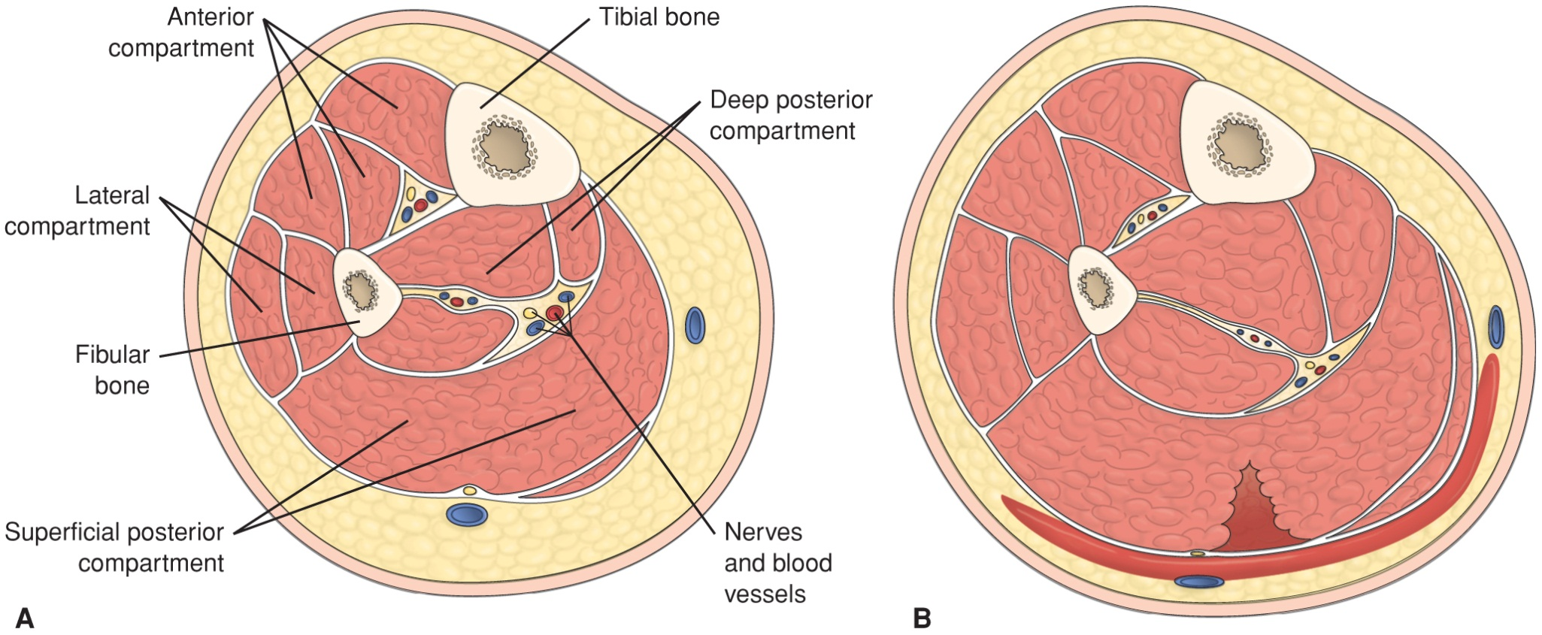
Cross-Section of Normal Muscle Compartments and Cross-Section with Compartment Syndrome

Slide 14
Nursing Process: The Care of the Patient with a Brace, Splint, or Cast—Interventions
1. Relieving pain
Elevation to reduce edema
Intermittent application of ice or cold
Positioning changes
Administration of analgesics
Note: Unrelieved pain may indicate compartment syndrome; discomfort due to pressure may require change of cast
2. improved physical mobility , Muscle-setting exercises see Chart 40
3. Patient teaching, achievement of maximum level of self-care see Chart 40

Slide 15
Interventions
4. Healing skin wounds and maintaining skin integrity
Treat wounds to skin before the brace, splint, or cast is applied
Observe for signs and symptoms of pressure or infection
Note: Patient may require tetanus booster
5. Maintaining adequate neurovascular status
Assess circulation, sensation, and movement
Five “P’s”
Notify physician of signs of compromise at once
Elevate extremity no higher than the heart
Encourage movement of fingers or toes every hour

Slide 16
External Fixation Devices
Used to manage open fractures with soft tissue damage
Provide support for complicated or comminuted fractures
Patient requires reassurance due to appearance of device
Discomfort is usually minimal and early mobility may be anticipated with these devices.
Elevate to reduce edema
Monitor for signs and symptoms of complications including infection
Pin care
Patient teaching

Slide 17
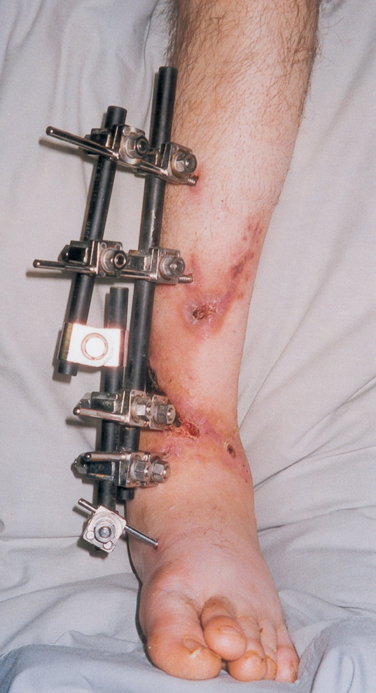
External Fixation Device

Slide 18
Traction
The application of pulling force to a part of the body
Purposes:
Reduce muscle spasms
Reduce, align, and immobilize fractures
Reduce deformity
Increase space between opposing forces
Used as a short-term intervention until other modalities are possible

Slide 19
All traction needs to be applied in two directions. The lines of pull are “vectors of force.” The result of the pulling force is between the two lines of the vectors of force.

Slide 20
Principles of Effective Traction
Whenever traction of applied a counterforce must be applied. Frequently the patient’s body weight and positioning in bed supply the counterforce.
Traction must be continuous to reduce and immobilize fractures.
Skeletal traction is never interrupted.
Weights are not removed unless intermittent traction is prescribed.
Ropes must be unobstructed and weights must hang freely.
the foot must not touch the footplate of the bed.

Slide 21
Types of Traction
Skin traction
Buck’s extension traction
Cervical head halter
Pelvic traction
Skeletal traction

Slide 22
Types of tractions:
I. Skin traction: is used to control muscle spasm and to immobilize an area before surgery. No more than 2-3.5 kg of traction should be used, pelvic traction 4.5 to 9 kg depending on the patient weight
Complications:
Skin breakdown, nerve pressure (drop foot), and circulatory impairment ( DVT)
Nursing interventions:
Ensuring effective traction
Monitor and managing potential complications

Slide 23
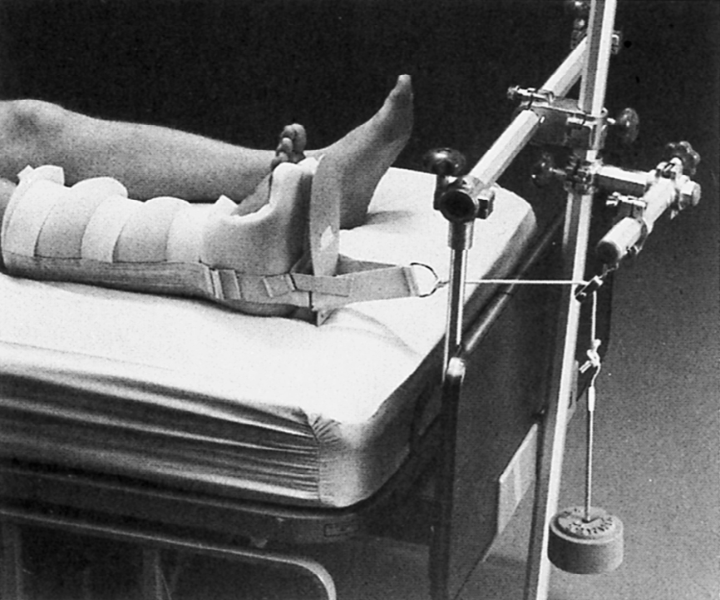
Buck’s Extension Traction

Slide 24
Types of tractions (cont…):
II. Skeletal traction: applied directly to the bone by using metal pin or wires. Most frequently used to treat fracture of long bones and the cervical spine. Is a surgical procedure. Skeletal traction uses 7-12 kg, as the muscle relax the traction weight is reduced to prevent fracture dislocation and to promote healing
After removing the traction cast or splint are then used to support the healing bone.

Slide 25
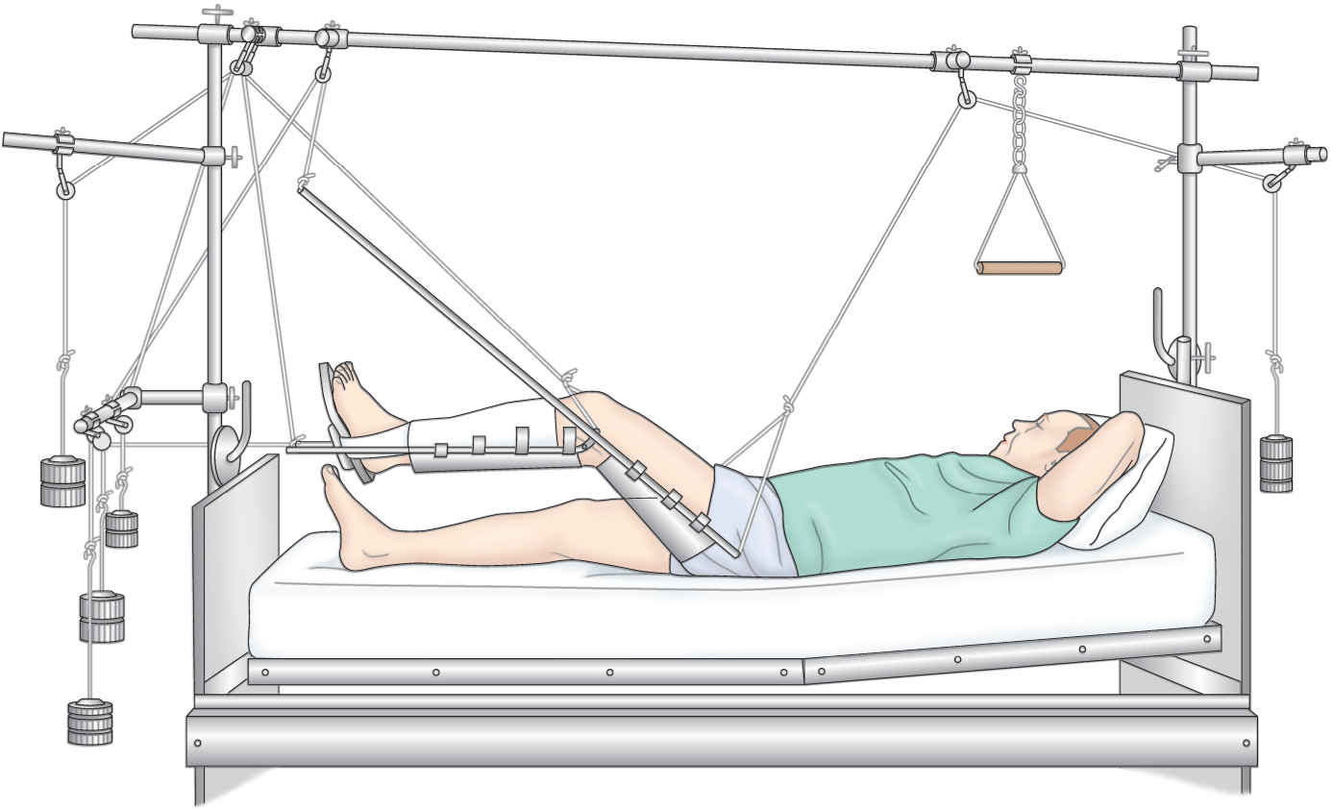
Balanced Skeletal Traction with Thomas Leg Splint

Slide 26
Nursing intervention of the Patient in Traction
Proper application and maintenance of traction
Maintaining Positioning
3 .Monitor for complications of skin breakdown,
Inspect skin at least three times a day
Palpate traction tapes to assess for tenderness
Assess sensation and movement

Slide 27
Interventions
4.Monitoring Neurovascular Status
Assess pulses color capillary refill, and temperature of fingers or toes
Assess for indicators of DVT
Assess for indicators of infection
5.Providing Pin Site Care
The goal is to avoid infection and development of osteomyelitis
first 48 hours after insertion, the site is covered with a sterile absorbent nonstick dressing and a rolled gauze.
After the first 48 to 72 hours following skeletal pin placement, pin site care should be performed daily or weekly.

Slide 28
Interventions
3. Chlorhexidine 2 mg/mL solution is the most effective cleansing solution.
4. Strict handwashing before and after skeletal pin site care should always take place.
The nurse must inspect the pin sites every 8 hours for reaction prophylactic broad-spectrum IV antibiotics may be given for 24 to 48 hours postinsertion to prevent infection;
6 .Promoting Exercise
7. Measures to reduce anxiety
Encourage patient participation in decision- making and in care
Frequent visits (family and of caregivers/nurse) to reduce isolation

Slide 29
Collaborative Problems/Potential Complications
Pressure ulcer
Atelectasis
Pneumonia
Constipation
Anorexia
Urinary stasis and infection
DVT

Slide 30
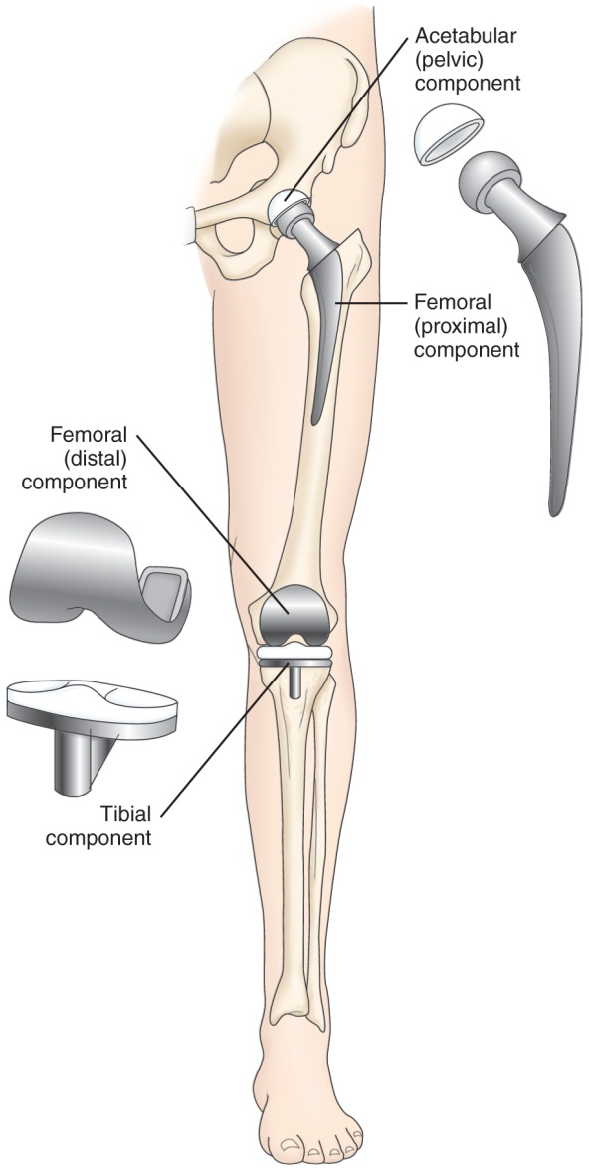
Joint Replacements
Used to treat severe joint pain and disability and for repair and management of joint fractures or joint necrosis.
Frequently replaced joints include the hip, knee, and fingers.
Joints including the shoulder, elbow, wrist, and ankle may also be replaced.

Slide 31
Nursing Process: The Care of the Patient Undergoing Orthopedic Surgery—Assessment, Preoperative
1. Complete nursing admission documentation
A. Biographic data
B. History ( P illness , ROS , past medical , surgical history , medication, allergy , smoking , alcohol , ect. )
2. Ensure vital signs are completed.
3. Ensure neurovascular observations are completed
4. Ensure doing following investigation:
A. CBC , renal function test , viral hepatitis , other

Slide 32
B. (ECG) if 50 years or above and/or if required, chest X ray
5. Ensure Venous Thromboembolism (VTE) prophylaxis is in place including sequential compression device (SCD) and graduated stockings on both limbs
6. Ensure the patient has fasted 6 hr. prior to surgery
7. Ensure the patient has showered/washed on the morning of surgery with Microshield Chlorhexidine 2%
8. Ensure inform consent

Slide 33
9. psychosocial support , special request.
10 Ensure the following :
A. operation site is marked
B. patient takes their essential regular medications on the morning of surgery
C. pressure injury prevention and document skin integrity
D. No systemic or local infection within 2 weeks
E. Complete pre-operative checklist.

Slide 35
Nursing Process: The Care of the Patient Undergoing Orthopedic Surgery—Assessment, Postoperative
1 .Pain
2.Vital signs, including respirations and breath sounds
3.LOC
4.Neurovascular status and tissue perfusion
5.Signs and symptoms of bleeding—wound drainage
6.Mobility and understanding of mobility restrictions
Patients usually begin ambulation within a day after surgery using walker or crutches.
Weight-bearing as prescribed by the physician
7.Bowel sounds and bowel elimination
8.Urinary output
9 .Signs and symptoms of complications—DVT or infection

Slide 36
Collaborative Problems/Potential Complications—Postoperative
Hypovolemic shock
Atelectasis
Pneumonia
Urinary retention
Infection
Infection may occur in the immediate postoperative period (within 3 months), as a delayed infection (4–24 months), or due to spread from another site (more than 2 years)
Thromboembolism—DVT or PE
Constipation or fecal impaction

Slide 37
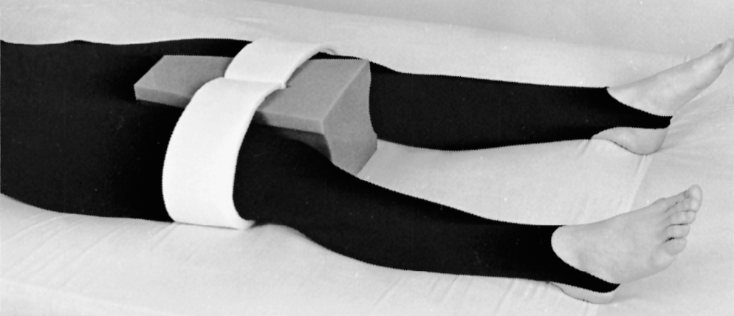
Use of an Abduction Pillow to Prevent Hip Dislocation After Total Hip Replacement

Slide 38
Hip Prosthesis
Positioning of the leg in abduction to prevent dislocation of the prostheses
Do not flex hip more than 90°
Avoid internal rotation
Protective positioning include maintaining abduction, avoiding internal and external rotation, hyperextension, and acute flexion

Slide 39
Knee Prostheses
Encourage active flexion exercises
Use of continuous passive motion (CPM) device

Slide 40
CPM Device

Slide 41
Nursing Process: The Care of the Patient Undergoing Orthopedic Surgery—Planning
Major goals preoperatively and postoperatively may include the relief of pain, adequate neurovascular function, health promotion, improved mobility, and positive self-esteem.
Postoperative goals include the absence of complications.

Slide 42
Nursing Process: The Care of the Patient Undergoing Orthopedic Surgery—Interventions
1.Relief of pain
Administration of medications
Patient-controlled analgesia (PCA)
Use alternative methods of pain relief
Repositioning, distraction, guided imagery. etc.
Specific individualized strategies to control pain
Use of ice or cold
Elevation
Immobilization

Slide 43
Interventions
2.Muscle setting, ankle and calf-pumping exercises
3 Measures to ensure adequate nutrition and hydration
4.Skin care measures including frequent turning and positioning
5. Follow physical therapy and rehabilitation programs
6. Encourage the patient to perform self-care within limits of the therapeutic regimen

Slide 44
Interventions
7. Preventing atelectasis and pneumonia
Encourage coughing and deep breathing exercises
Use of incentive spirometry
8.Constipation
Monitoring of bowel function
Hydration
Early mobilization
Stool softeners
9 .Patient teaching
10. Wound care and drain monitoring

